Slide 1
OpenAI API Overview
Generative AI for creating content

Slide 2
API Options for text generation
Chat Completion
Text Completion

Slide 3
Other API features
Image Generation
Audio Transcription
File parsing for fine tuning
Embedding
Content Moderation

Slide 4
What can you do with it
Summarization
Chat AI
Translation
Data Extraction
Classification, Categorization, and Sentiment Analysis
More

Slide 5
Use the OpenAI Python Library
Install the library using pip by running this command in your terminal
pip install --upgrade openai
Link: https://github.com/openai/openai-python

Slide 6
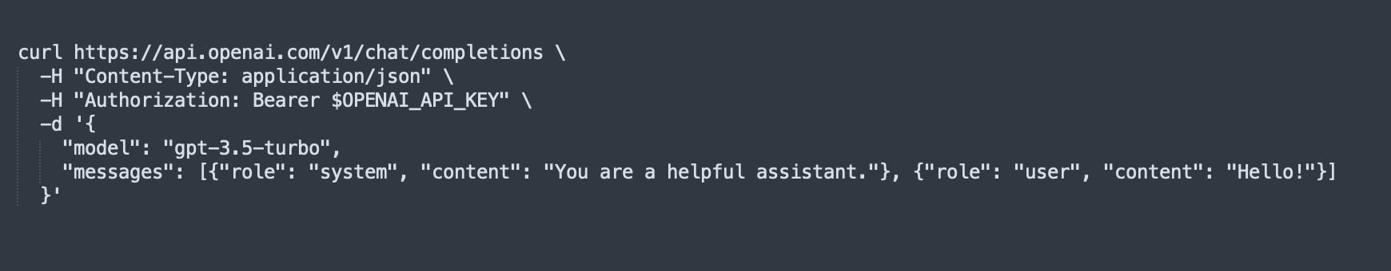
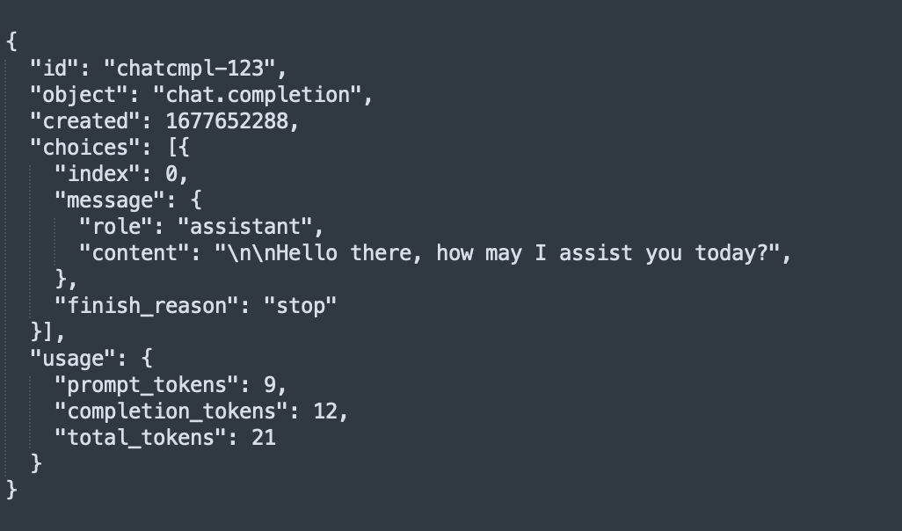
Sample Chat Completion API call
Query:
Response:

Slide 7
Important Parameters
Model - Text model for use,
Max Tokens - Maximum number of characters for response
Temperature - Number from 0 to 2, changes the variance in responses. For example, temperature of 0.8 would make responses more random.
N - Number of chat completion choices to generate per input message
Full list of parameters are here https://platform.openai.com/docs/api-reference/chat/create

Slide 8
Try it yourself
Copy and paste this into your terminal.
OPENAI_API_KEY=<Secret Key>;
curl https://api.openai.com/v1/chat/completions \
-H "Content-Type: application/json" \
-H "Authorization: Bearer $OPENAI_API_KEY" \
-d '{
"model": "gpt-3.5-turbo",
"messages": [{"role": "system", "content": "You are a helpful developer"}, {"role": "user", "content": "Hello!"}]
}'

Slide 9
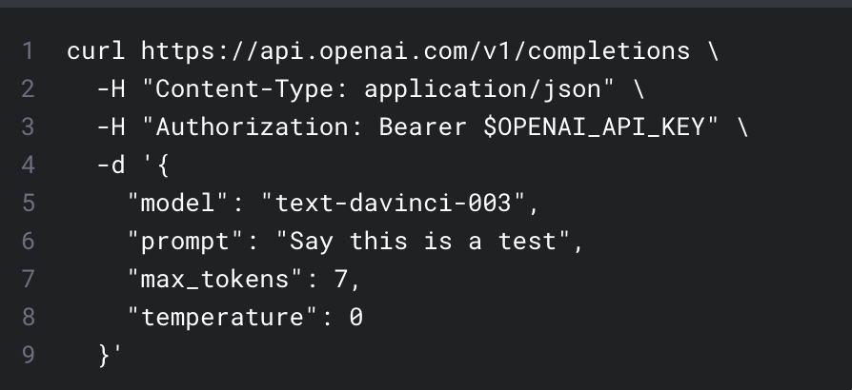
Sample Completion API
This uses the v1/completions API to complete a prompt
This prompt is “Say this is a test” and uses the text-davinci-003 with a maximum number of words of 7

Slide 10
Sample Response
Response: This is indeed a test!
This has less than the maximum number of tokens (7)
Davinci 3 is variation of the models that OpenAI provides
https://platform.openai.com/docs/models

Slide 11
Try it yourself
OPENAI_API_KEY=<Secret Key>;
curl https://api.openai.com/v1/completions \
-H "Content-Type: application/json" \
-H "Authorization: Bearer $OPENAI_API_KEY" \
-d '{
"model": "text-davinci-003",
"prompt": "Is there cake at the end?",
"max_tokens": 7,
"temperature": 0
}'
Hint: Replace the secret key with your secret key and paste it into the terminal

Slide 12
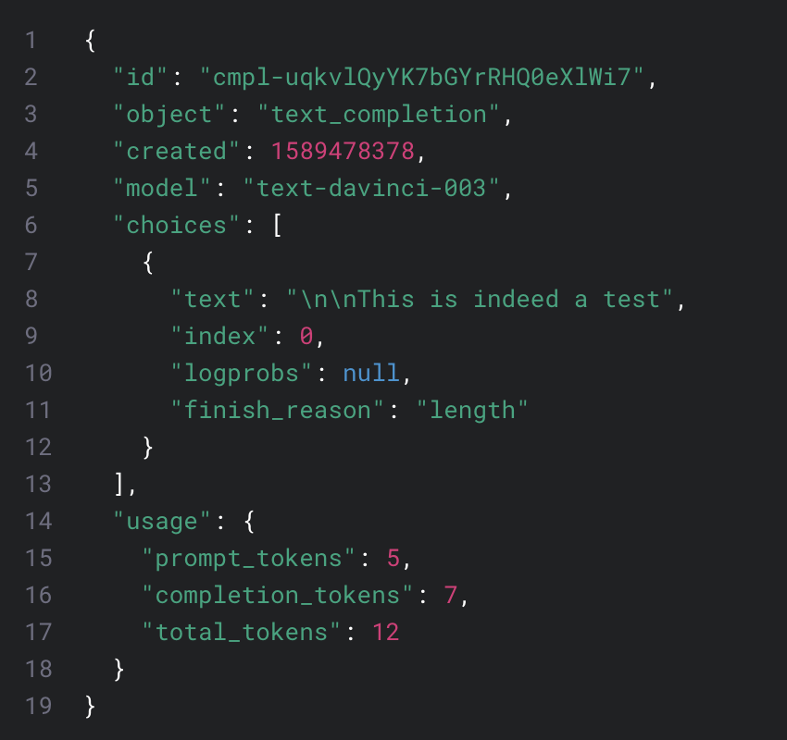
The Response
The response is “\n\nThis is indeed a test” which has 7 tokens (\n, \n, This, is, indeed, a test) which ends up terminating the response

Slide 13
Context and Tokens
Tokens are the number of characters in a prompt
Context is the total number of tokens that the AI model can consider when making a response.
A model that is capable of handling more tokens can consider more words when generating a response and might be able to create a response that is more accurate than a model that has a smaller context window.
Typically context size is in the model name
Gpt-3.5-16k => 16k context length
Gpt-4-32k => 32k context length

Slide 14
OpenAI models
You can find a list of models here: https://platform.openai.com/docs/models/gpt-4
The popular ones are
gpt-4
gpt-4-32k
gpt-3.5-turbo
gpt-3.5-turbo-16k
text-davinci-003 (legacy)
code-davinci-002 (legacy)

